Slide 1
Austin Housing Prices
Using Data Science to Predict Housing Prices in Austin, Texas

Slide 2
Overview
Research Question:
Can we predict housing prices in the Austin area based on a number of factors?
Reason Topic Was Selected:
As Austin based residents, we are curious to see if we can find any trends in our data that will help predict housing prices here in our city.

Slide 3
Source of Data
After searching for data on current housing prices in the Austin area, we found a thorough and relatively clean set on Kaggle. A web scraper was used on Zillow to create this dataset. With four years of data and over 700 columns in the original dataset, we have the following information readily available:
Identifiers: zillow id, address, zip codes
Pricing: latest price, latest sale date
Unique Factors: average school distance, average school rating

Slide 4
We hope to answer our question: Can we predict housing prices in Austin, Texas based on a number of features?

Slide 5
Data Exploration
Exploring the data helped us tighten up our research question. Zeena loaded in the CSV file to explore the data in a few ways using Pandas:
She analyzed the data types
Filtered to single family homes
Checked for null values
Filtered data only including Austin city
Dropped columns with no importance
Removed columns that couldn’t convert to numerical data
Changed “latest_saledate” to a date format
Questions we asked ourselves:
What are our variables?
Are there any missing values?
Do we need to transform any of the data so it can be uniform across the columns?
Do we need to bring in any other datasets?
Are there any outliers that will skew our data?

Slide 6
Analysis Phase
Once we had a good look at our data and Barrett connected the database to Jupyter Notebook, we started testing it in the machine learning model that Claire had built and tested previously.
Compared Models:
Random Forest Regression
Linear Regression
After comparing the accuracy of the ML models, the better performing model was chosen.

Slide 7
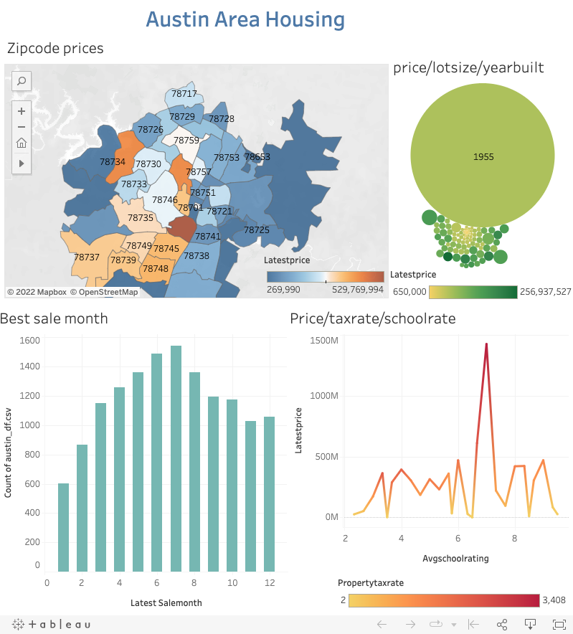
Dashboard:
Interactive dashboard link to tableau public:
https://public.tableau.com/views/dashboard1_16584263247130/Dashboard1?:language=en-US&publish=yes&:display_count=n&:origin=viz_share_link
Description of interactive tools:
Heat map of zip codes and housing prices
Bar graph of month and price sold
Bubble chart of price/lot size/ year built
Line graph of price and average school rating

Slide 8
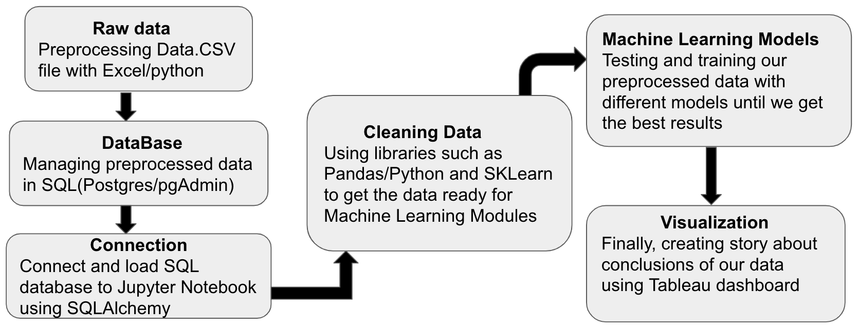
Description of tools used to create final dashboard in a project map:

